Slide 1
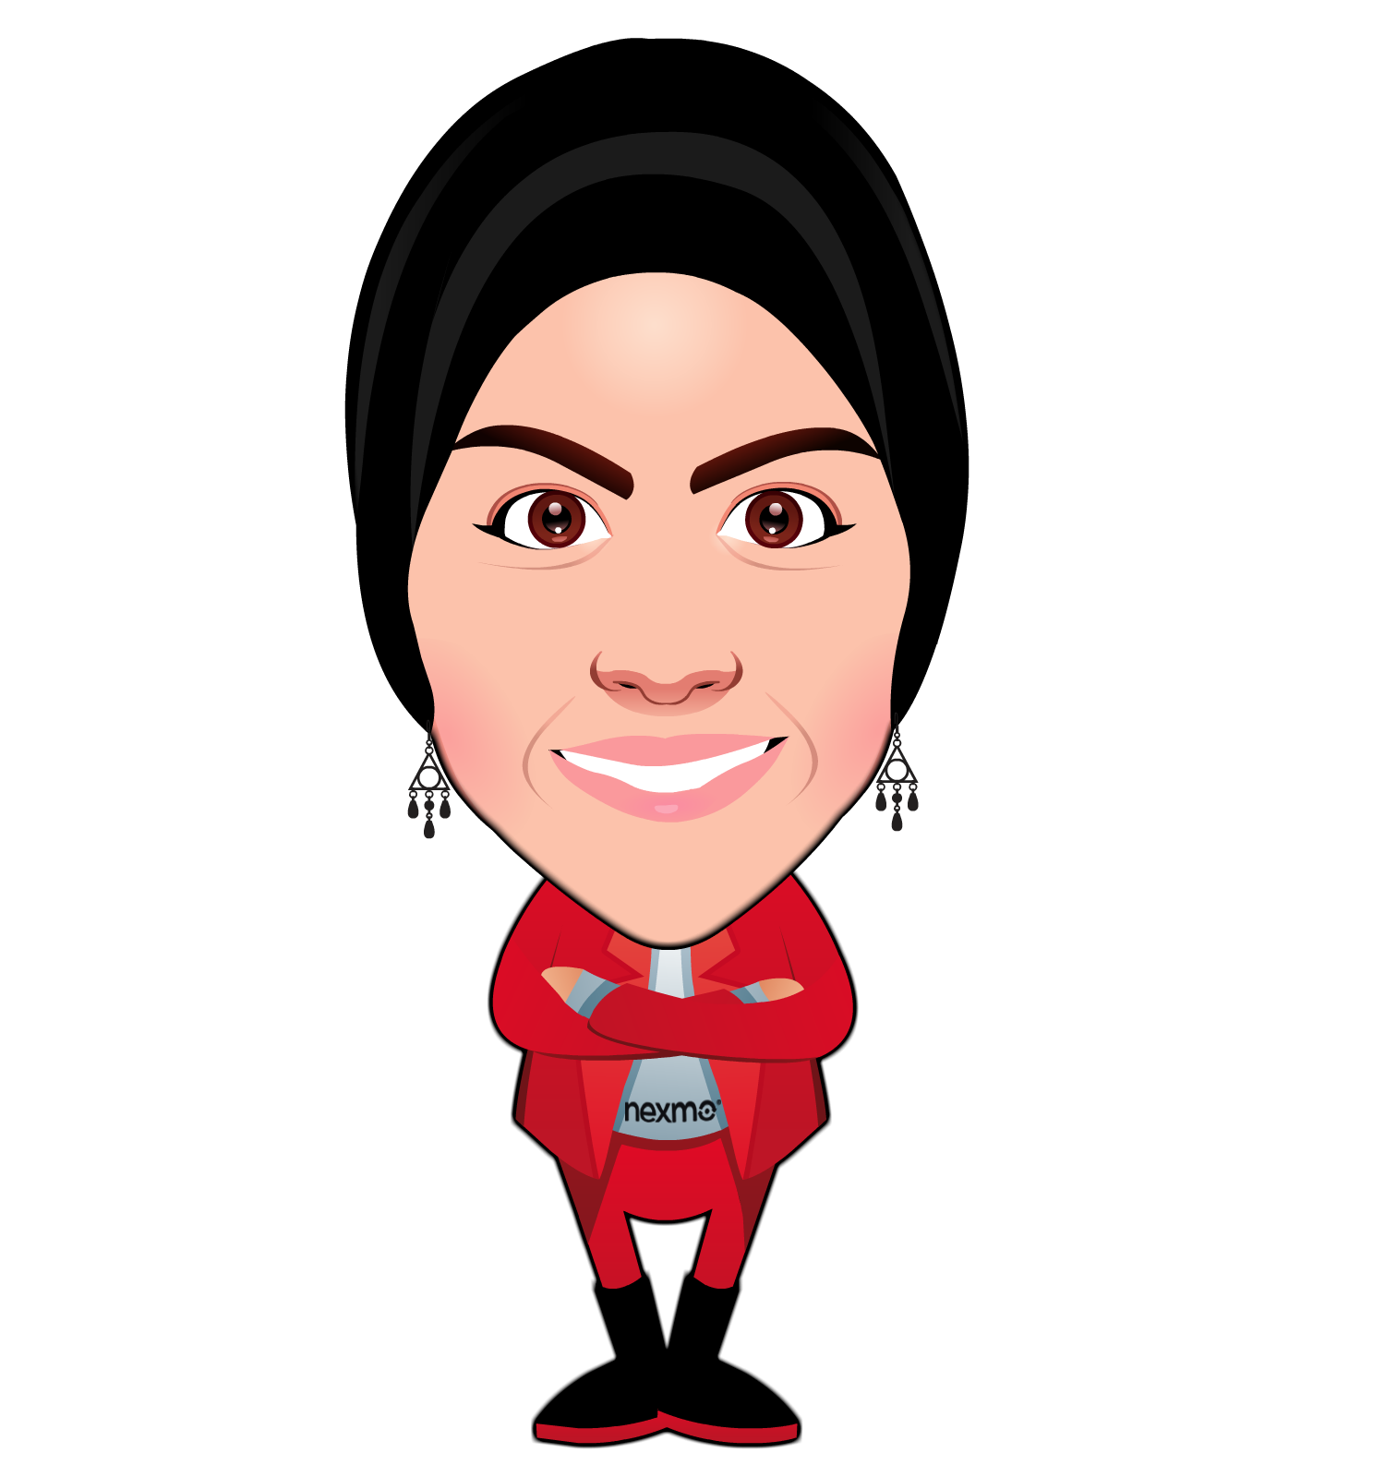
Bots, Voice and the Future
Rabeb Othmani
Developer Advocate, Nexmo

Slide 2




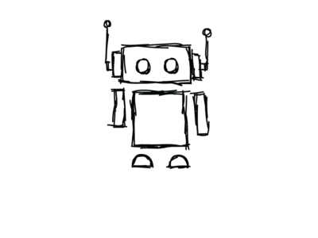
What’s a Bot?
A software application
Runs automatically or executes commands
Chatbots, digital assistants, etc…

Slide 3
The Rise of Bots
~45% of end users prefer chatbots as the primary mode of communication for customer service inquires.*
Consumer Intelligence Research Partners (CIRP) estimates that 8.2 million people own an Amazon Echo device
Alexa has over 11000 skills.**
by 2019, the voice recognition market will be a $601 million industry.***
*source: Grand View Research report
**source: PC Magazine
***source: Technavio

Slide 4
What fuelled The Rise of Bots?
New era of computing
Boom of Artificial Intelligence
Advances in machine learning
Advances in language technologies (Text-to-speech, natural language processing, etc.)

Slide 5

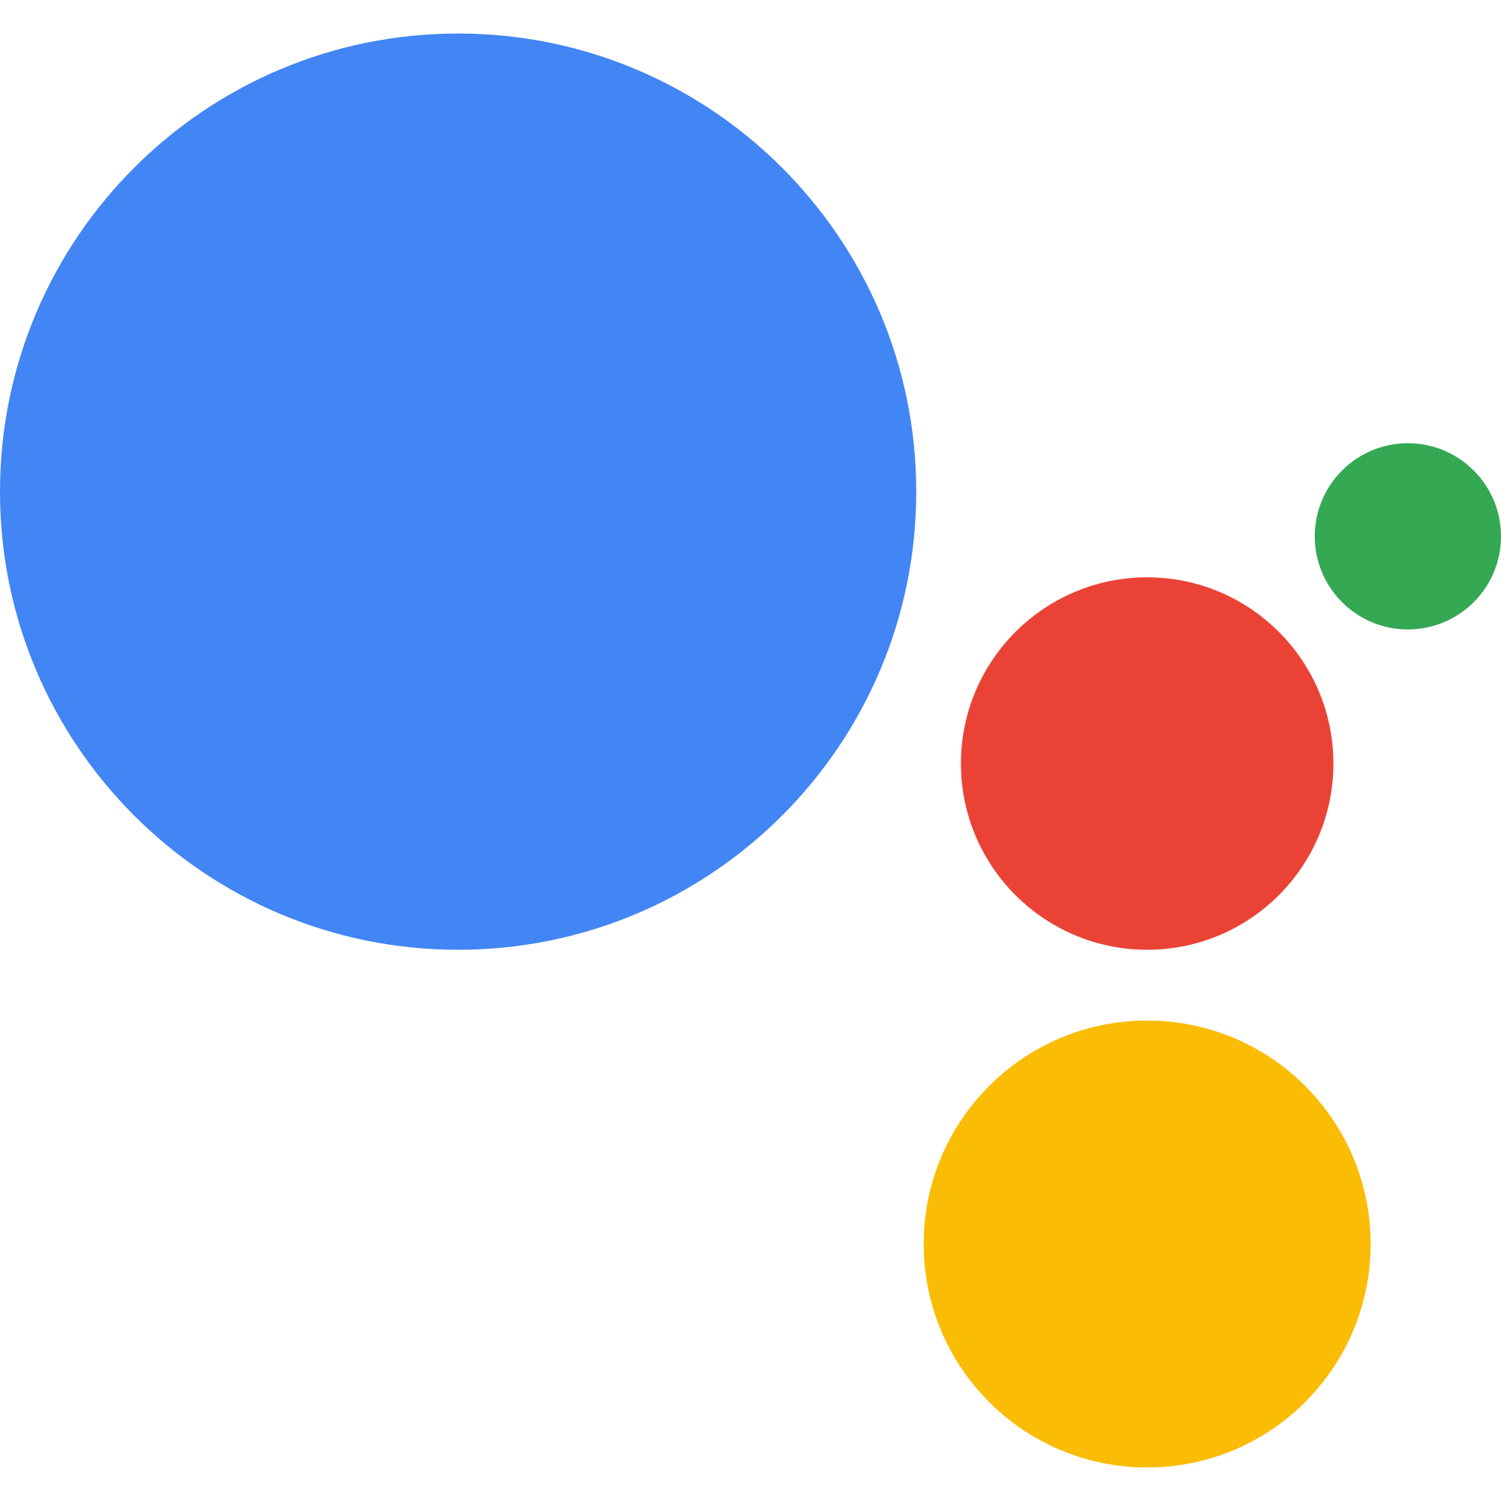

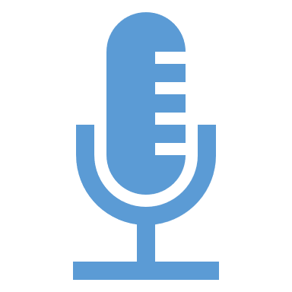

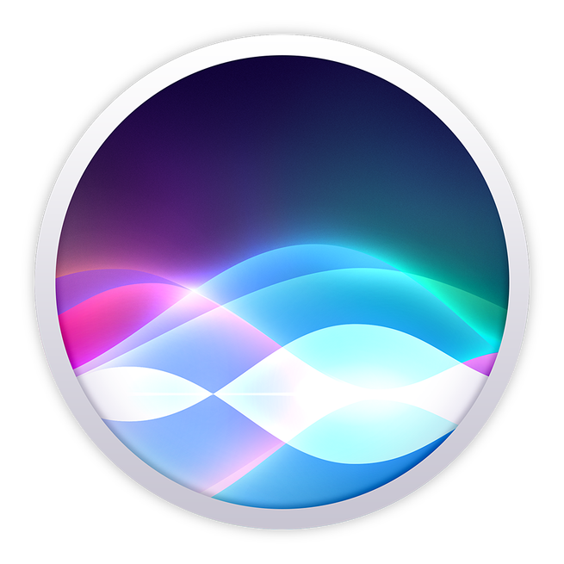
Voice as a Primary Conversational Interface

Slide 6

Voice as a Primary Conversational Interface
A natural mean of interaction
Frictionless experience
Fast, simple & everywhere

Slide 7
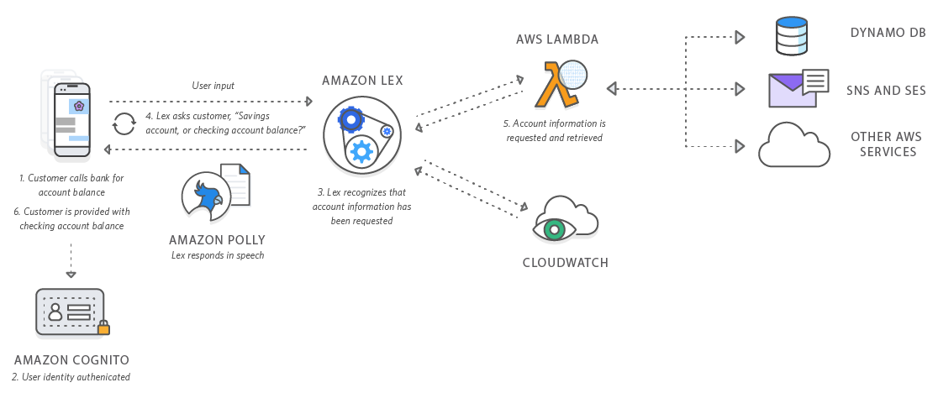
A World of Opportunities

Slide 8
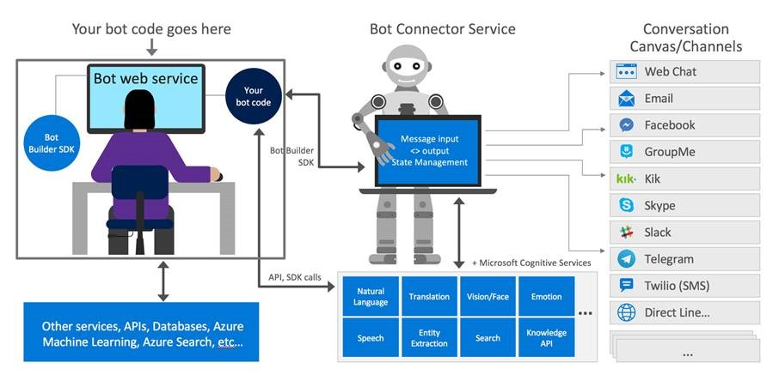
A World of Opportunities

Slide 9
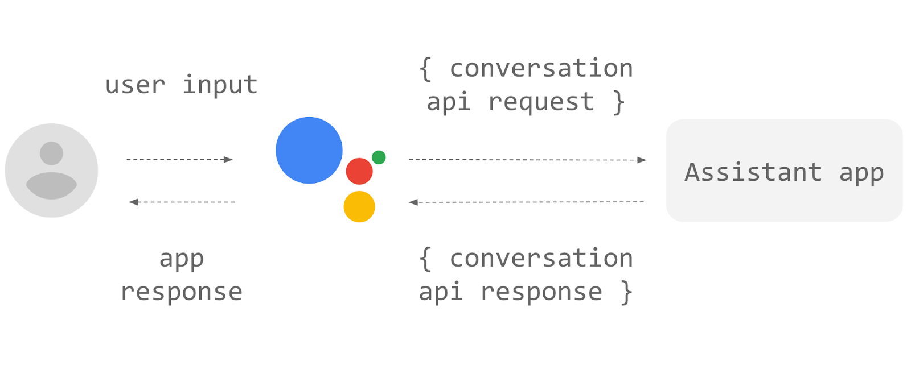
A World of Opportunities

Slide 10
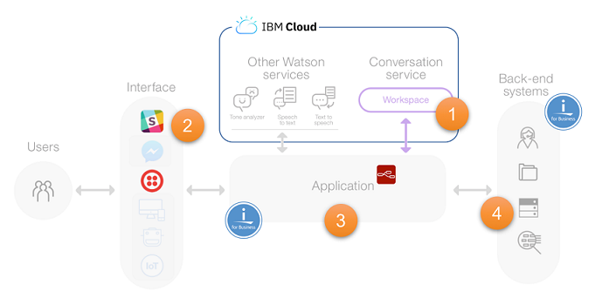
A World of Opportunities

Slide 11
Challenges & Considerations
Make it smart
How to understand the user intentions?
User language
Use a language that the user can understand and relate to.
The capabilities of your tech
Is the natural language processing advanced enough?
When to reply?

Slide 12
Thank you!
https://rabebothmani.com
@Rabeb_Othmani
@NexmoDev

